Slide 1
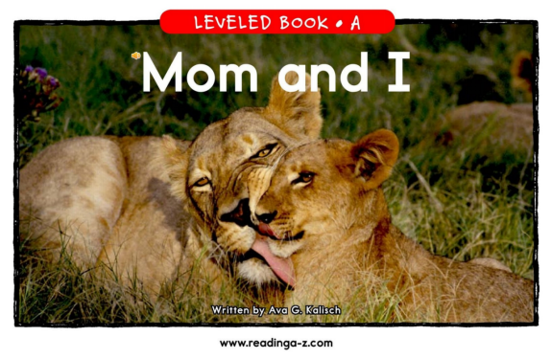

Slide 2
Click on the colored buttons to start getting to know them!
lion
elephant
giraffe
zebra
bear
ape
kangaroo
dolphin

Slide 3
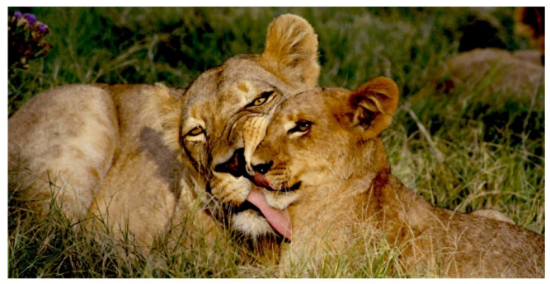
Mom and I are lions.
Return

Slide 4
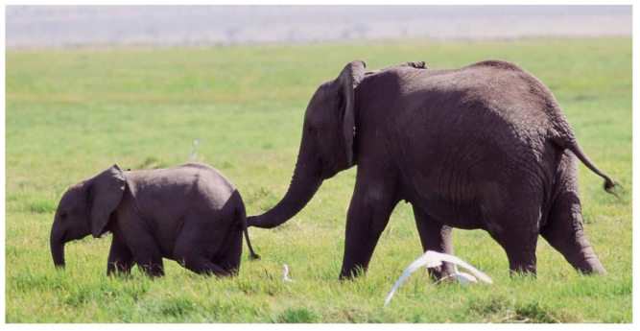
Mom and I are elephants.
Return

Slide 5
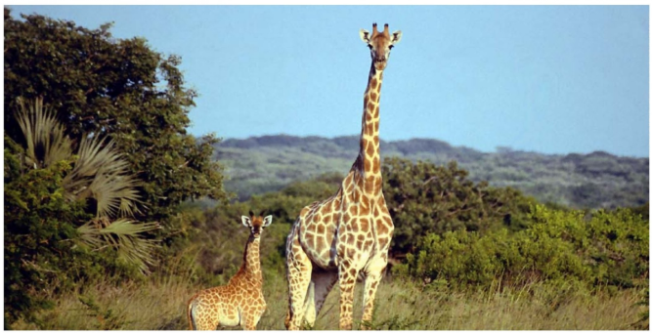
Mom and I are giraffes.
Return

Slide 6
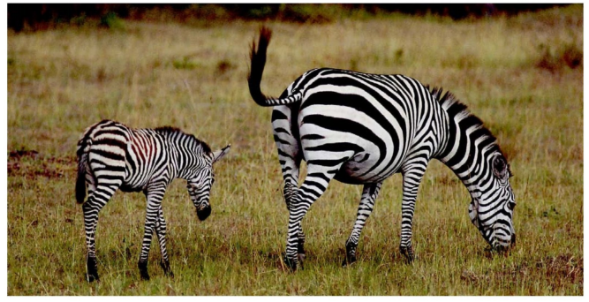
Mom and I are zebras.
Return

Slide 7
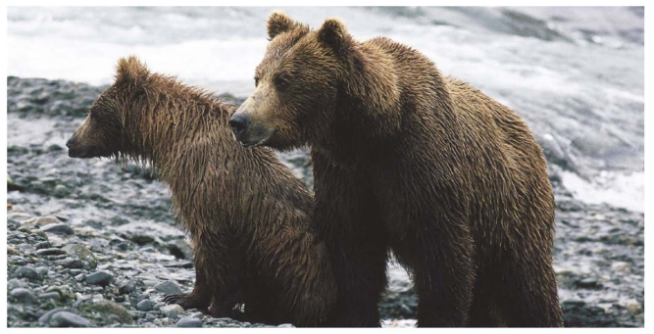
Mom and I are bears.
Return

Slide 8
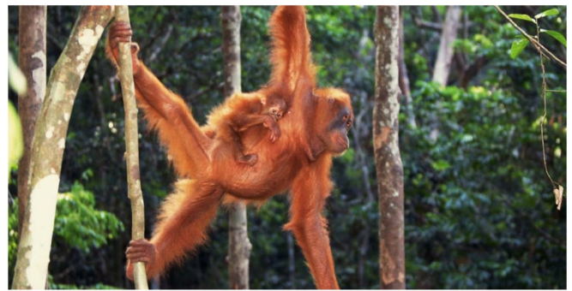
Mom and I are apes.
Return

Slide 9
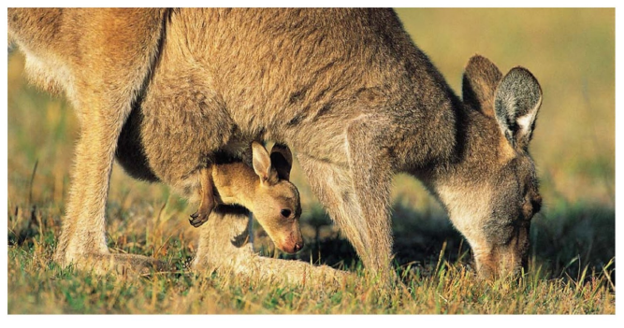
Mom and I are kangaroos.
Return

Slide 10
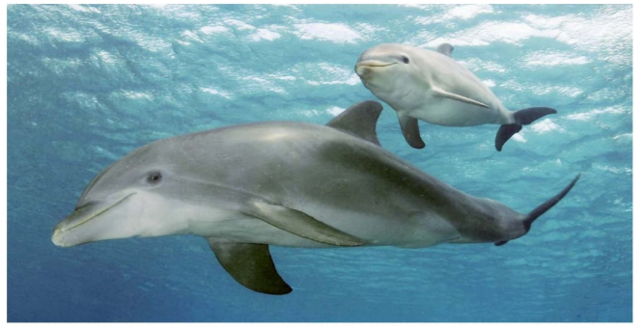
Mom and I are dolphins.
Return

